Slide 1
INVESTMENT ASSIGNMENT
SUBMISSION
Name: Somanath Bhuyan

Slide 2
Investment Assessment
Spark Funds wants to make investments in a few companies. The objective is to identify the best sectors, countries, and a suitable investment type for making investments. The overall strategy is to invest where others are investing, implying that the 'best' sectors and countries are the ones 'where most investors are investing'.
Spark Funds has two minor constraints for investments:
It wants to invest between 5 to 15 million USD per round of investment
It wants to invest only in English-speaking countries because of the ease of communication with the companies it would invest in
Strategy :
Spark Funds wants to invest where most other investors are investing. This pattern is often observed among early stage startup investors.
Data Source for Insights : crunchbase.com

Slide 3
Flow of assessment of investment opportunity
Get Data
Data Cleaning
Merge Data
Perform Operation
Draw Insights
The representative amount of investment in each funding type.
top 9 countries against the total amount of investments of funding type FT.
the number of investments in the top 3 sectors of the top 3 countries

Slide 4
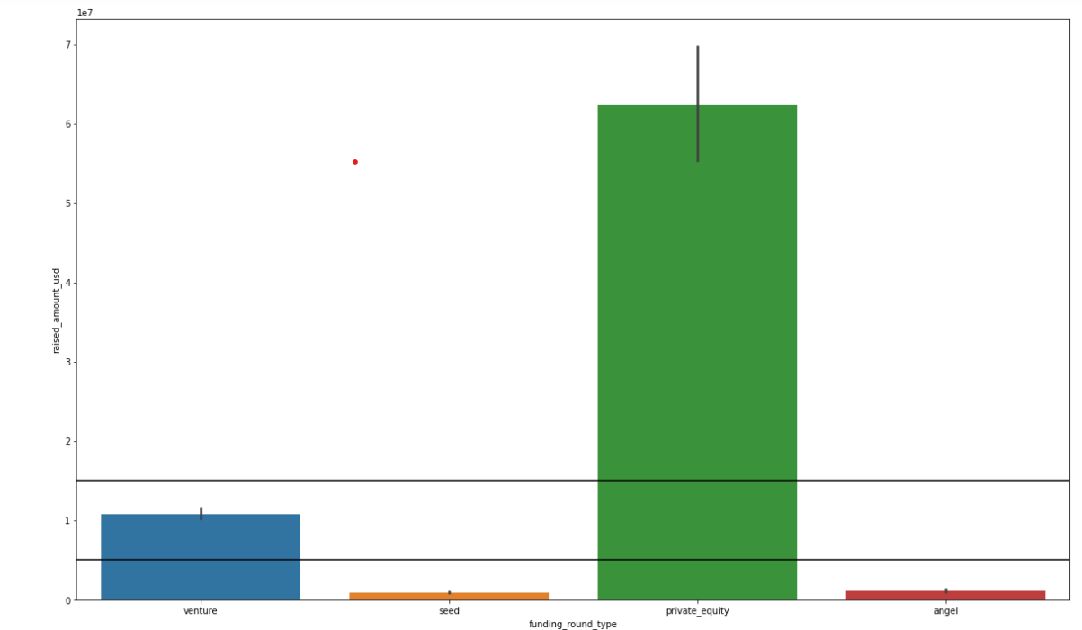
A plot showing the representative amount of investment in each funding type. This chart should make it clear that a certain funding type (FT) is best suited for Spark Funds

Slide 5
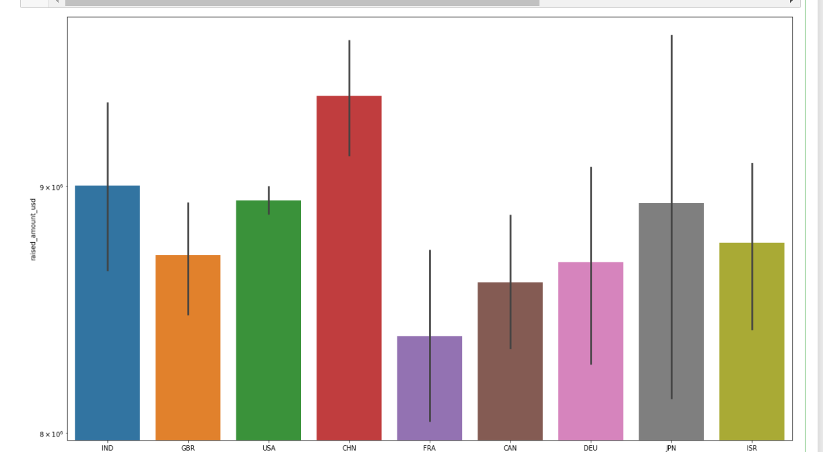
A plot showing the top 9 countries against the total amount of investments of funding type FT. This should make the top 3 countries (Country 1, Country 2, and Country 3) very clear.

Slide 6
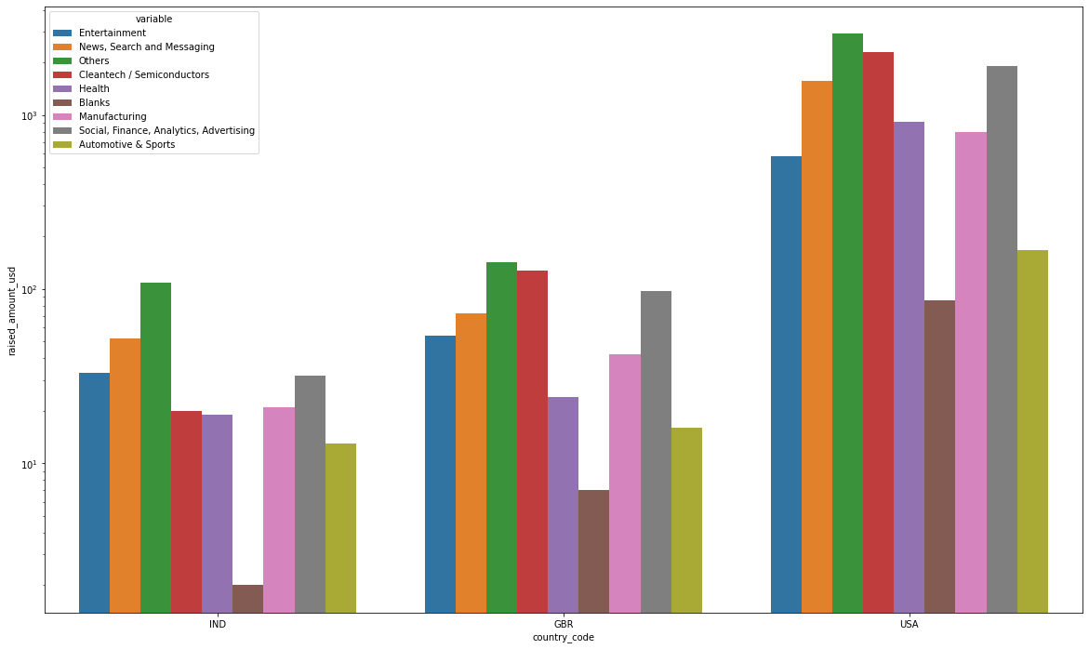
Countries wise Sector Investment chart.

Slide 7
Final Recommendation
Countries | USA | UK/GBR | IND
Sector 1 | Others | others | Others
Sector 2 | Cleantech / Semiconductors | Cleantech / Semiconductors | News, Search and Messaging
Sector 3 | Social, Finance, Analytics, Advertising | Social, Finance, Analytics, Advertising | Entertainment

